Slide 1
SALES DATA ANALYSIS
PENS AND PRINTERS

Slide 2
Overview and business goals
Project Overview
Pens and Printers, founded in 1984, is a trusted provider of high-quality office supplies for large organizations. Our success is built on strong, long-lasting customer relationships, where clients rely on us for products that boost their productivity and creativity. As consumer buying habits evolve, we are dedicated to adapting our sales strategies to continue delivering the best products and services to meet our customers' needs.
Business Goals
Adapt Sales Tactics: Identify the most effective sales techniques for new products as consumer buying behavior changes.
Optimize Cost-Efficiency: Use the best methods to maximize ROI when launching new product lines.
Test Sales Strategies: Evaluate the effectiveness of targeted emails, phone calls, and a combination of both for the new stationery line.
Enhance Customer Relationships: Continue building trust and loyalty by offering products that meet customer needs.

Slide 3
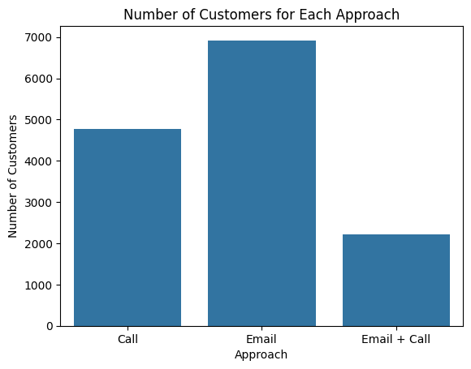
Outcomes
most used sales approach
Analysis indicates that email is currently the most used customer acquisition method, followed by phone calls, with the hybrid approach demonstrating the lowest amount of customers.

Slide 4
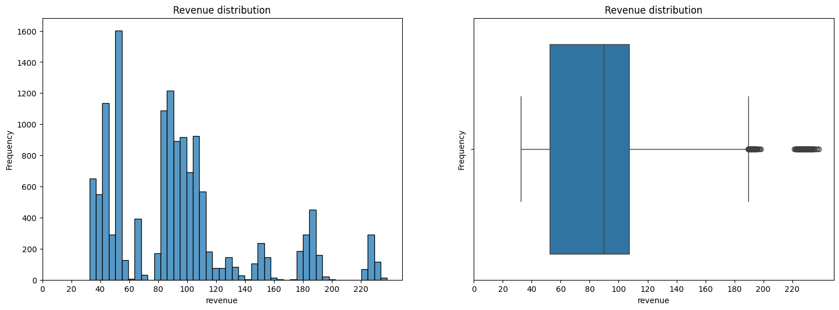
Outcomes
Overall Revenue
Our sales data shows a wide range, with most earnings falling between 40,000 and 120,000. However, we have some standout performers bringing in up to $220,000. This spread indicates diverse market performance.

Slide 5
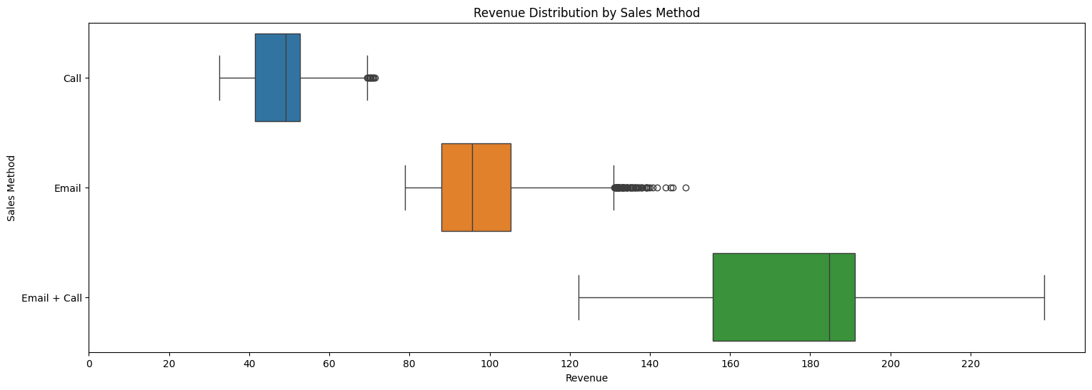
Outcomes
Revenue for each for each sales method
Sales data indicates email and call combined is the most effective strategy, yielding the highest average Revenue and potential for large deals. Cold calling has the lowest revenues. Email marketing shows better overall performance with some standout successes. This suggests we should focus on refining and expanding our integrated email and call campaigns to maximize our revenue potential.

Slide 6
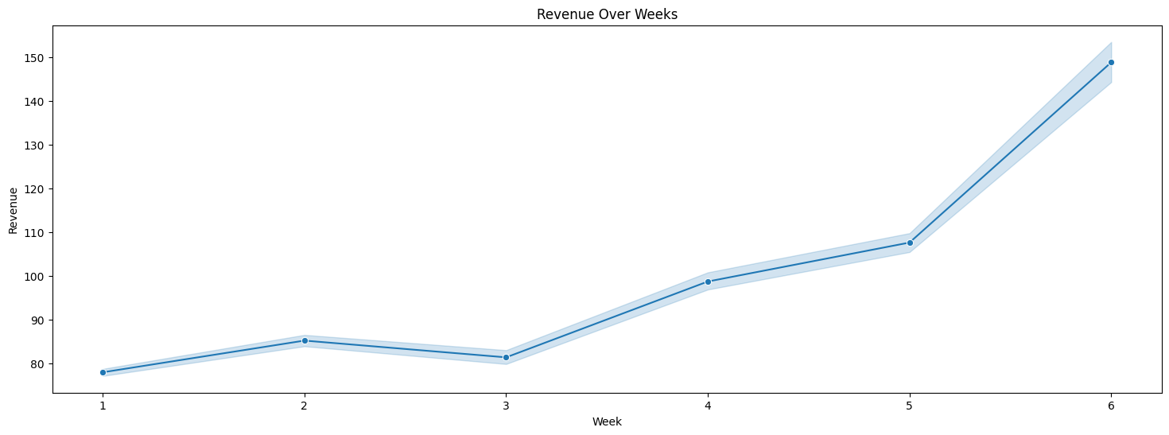
Outcomes
Revenue over time
The analysis shows that overall revenue grew steadily over the six-week period.

Slide 7
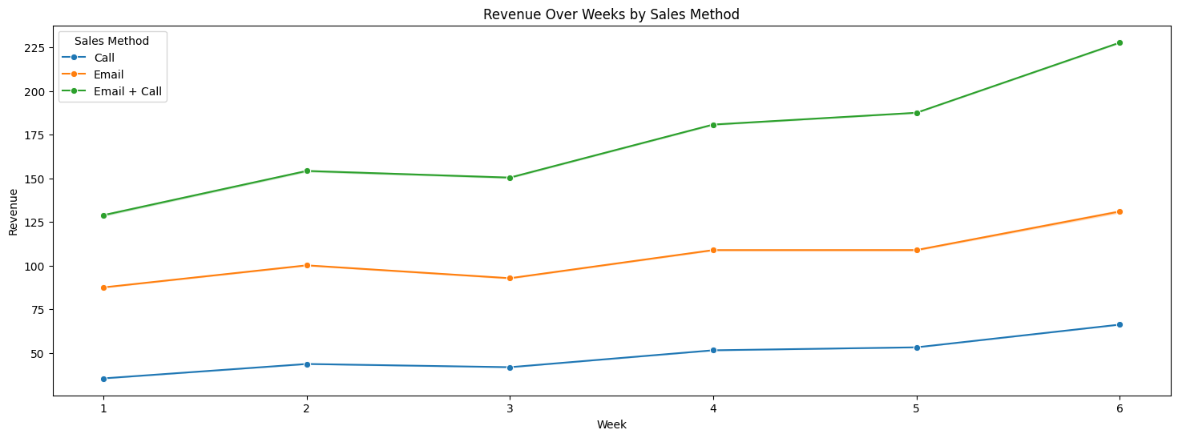
Outcomes
Revenue over time for each of the methods
Revenue from all sales methods increased over the six weeks period. The "Email + Call" method consistently generated the highest revenue, showing the most significant growth. The "Email" method also saw positive growth, while the "Call" method had the slowest increase. These findings suggest a combined sales approach is most effective, but there's potential for improvement in email and call strategies.

Slide 8
key findings
Email + Call: Most effective strategy, highest average revenue, with only 10 minutes of customer interaction.
Customer Acquisition: Email is the most used method; hybrid approach is the most effective but has the lowest customer count.
Email-Only: Strong performance with positive revenue growth and standout successes.
Cold Calling: Least efficient, lowest revenue, and highest time commitment (30 minutes per customer).
Revenue Growth: All methods saw increases, with the Email + Call approach showing the most significant growth.
Strategic Focus: Prioritize and expand integrated Email + Call campaigns to maximize revenue and efficiency.
Learn More

Slide 9
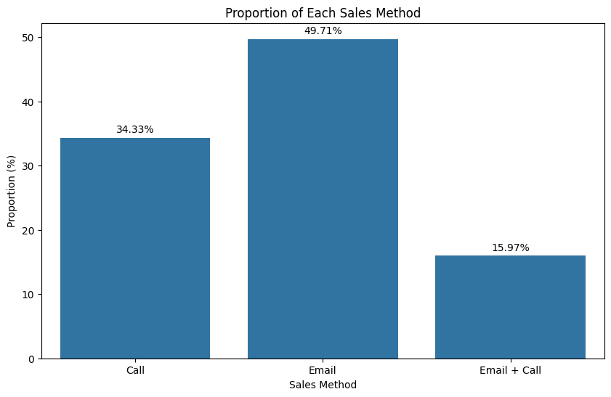
Business metric
Given the company's objective to sustain high revenue while adopting innovative sales strategies, the "email + call" approach percentage is a key business metric. This metric currently stands at 15.97% of total sales. This method demonstrates high revenue growth while maintaining efficient resource allocation and time efficiency, aligning with the company's goals. A strategic priority is to increase the utilization of this sales tactic. Additionally, overall revenue remains a crucial performance indicator for assessing overall company performance.

Slide 10
Recommendations
Prioritize the "Email + Call" Sales Method:
Encourage the sales team to focus on the "email + call" approach to optimize both revenue and time efficiency.
Consider training and resources to further improve the effectiveness of this method.
Monitor and Increase the Use of the "Email + Call" Approach:
Set targets to increase the utilization of this sales method, given its proven effectiveness.
Regularly track the percentage of sales using this approach as a key business metric.
Optimize Resource Allocation:
Reduce reliance on the "call-only" method, as it is less efficient and more time-consuming.
Allocate resources to support the more effective sales strategies, such as "email + call" and "email-only" methods.

Slide 11
THANK YOU
PENS AND PRINTERS

